Slide 1

MultiJuicer DeepDive

Slide 2


https://github.com/iteratec/multi-juicer

Slide 3






Robert Seedorff CISO @ iteratec OWASP Member
Jannik Hollenbach Security Engineer @ iteratec OWASP Juice Shop Core Team
@r_seedorff
@rseedorff
@j12934
@j12934
Notes:
Short introduction about us and our job at iteratec

Slide 4
Our passion is to deliver secure software because we believe that secure software development is crucial in a digital world
Developing secure software is not that hard as developer often might think
It all starts as always with a shared mindset + culture, learning by doing and of course security developer trainings 😉
Notes:
Start with why we are doing this as a company

Slide 5
🤔 How do you do hands-on security trainings?
Notes:
Ask the participants?

Slide 6

With OWASP Juice Shop, obviously 😉
95+ Challenges with lots of variability
Realistic challenges
Interactive Hacking Instructor for newbies
Open Source

Slide 7
But How?

Slide 8
Training Setup Comparison
You will find a recap of all three options here: https://youtu.be/6NMjZbfnTOU
 | Option #1 Local Installs | Option #2 “docker run ...” Hosting | Option #3 MultiJuicer
👍 | Managed by Participants Nothing to manage by you | Saves time during training Easy Setup | Saves time during training Single address Monitorable Scales automatically Somewhat cheat proof Automatically cleans up instances after trainings
👎 | Time Intensive during trainings Need to be a node expert | Managed by you Hard to monitor Multiple addresses Might be blocked in corporate networks | Managed by you Need to maintain kubernetes cluster

Slide 9
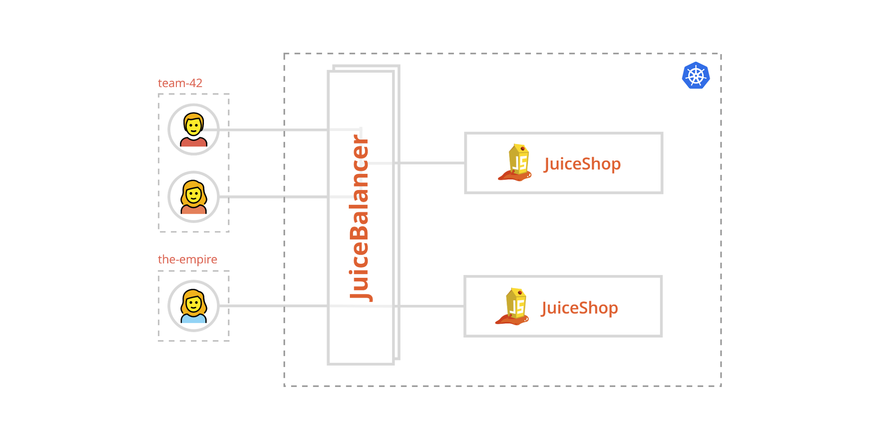
How it works

Slide 10
🚀 Demo 🚀
https://multijuicer.oss2020.security.iteratec.dev

Slide 11
How to install MultiJuicer?
Demo

Slide 12
Installing MultiJuicer
# Pull the helm repo helm repo add multi-juicer https://iteratec.github.io/multi-juicer/ # Install MultiJuicer
helm install multi-juicer multi-juicer/multi-juicer

Slide 13
Changing the Configuration 1/3
# View values
open https://artifacthub.io/packages/chart/multi-juicer/multi-juicer
# Install MultiJuicer with a value override
helm install multi-juicer multi-juicer/multi-juicer \ --set “balancer.service.type=LoadBalancer”

Slide 14
Changing the Configuration 2/3
# Steal Björn Config from the Configuring JuiceShop Session
https://github.com/OpenSecuritySummit/oss2020/blob/master/content/outcomes/OWASP-JuiceShop/deepdive-theming/oss17-final_touch.yml
# Saving as a helm values file: juiceShop:
config: |
application:
name: 'OpenSecuritySummit Store'
logo: https://open-security-summit.org/img/logo.png
welcomeBanner:
showOnFirstStart: false
theme: blue-lightblue
cookieConsent:
backgroundColor: '#23527c'
textColor: '#ffffff' …

Slide 15
Changing the Configuration 3/3
# Install with custom config file
helm install multi-juicer multi-juicer/multi-juicer \
--values ./values.yml --set “balancer.service.type=LoadBalancer”

Slide 16
Installing the Monitoring Stack
# For full instructions see the guide linked below # Install Prometheus & Grafana
helm --namespace monitoring upgrade --install prometheus stable/prometheus-operator \ --version 8.13.2 --values ./prometheus-operator-config.yaml
# Install Loki (Grafana Log Processor)
helm --namespace monitoring upgrade --install loki loki/loki \ --version 0.28.1 --set="serviceMonitor.enabled=true"
# Install Promtail (Loki Collector)
helm --namespace monitoring upgrade --install promtail loki/promtail \
--version 0.22.1 --set "loki.serviceName=loki" --set="serviceMonitor.enabled=true"
https://github.com/iteratec/multi-juicer/blob/master/guides/monitoring-setup/monitoring.md

Slide 17
Feature-Request ideas worth mentioning
Long Running MultiJuicer Setups
Scale JuiceShops Instance of inactive teams to zero
Delete instances completely when team hasn’t come back for a long time
Add “train the trainer” material:
How to organize (virtual) security trainings
Add more additional training materials already available at OWASP
MultiJuicer UI improvements
Add White label customizing: configure another logo / color / icons / hints
Move the custom ScoreBoard from Grafana to the MultiJuicer UI
SSO for Enterprise?
OpenIDConnect based authentication

Slide 18
How you can help?
👩‍💻 Try it out!
⭐️ Star the repo
🐛 File issues
🧾 Write setups guides for your favorite cloud
📢 Share your feedback and experience with us
github.com/iteratec/multi-juicer

Slide 19
Thanks for listening, stay safe!
github.com/iteratec/multi-juicer

